Slide 1
CS118 – Programming Fundamentals
Lecture # 12
Tuesday, October 02, 2019
FALL 2019
FAST – NUCES, Faisalabad Campus
Course Instructor:
Ebad Majeed
Slides Credit:
Rizwan Ul Haq

Slide 2
Why Is Repetition Needed?
Repetition allows you to efficiently use variables
Can input, add, and take average of multiple numbers using a limited number of variables
For example, to add five numbers:
Declare a variable for each number, input the numbers and add the variables together
Create a loop that reads a number into a variable and adds it to a variable that contains the sum of the numbers

Slide 3
while Looping (Repetition) Structure
The general form of the while statement is:
while is a reserved word
Statement can be simple or compound
Expression acts as a decision maker and is usually a logical expression
while is a pre-test loop
Statement is called the body of the loop
The parentheses are part of the syntax

Slide 4
while Loop Flow of Control
Infinite loop: continues to execute endlessly
Avoided by including statements in loop body that assure exit condition is eventually false
false
condition
true
statement(s)

Slide 5
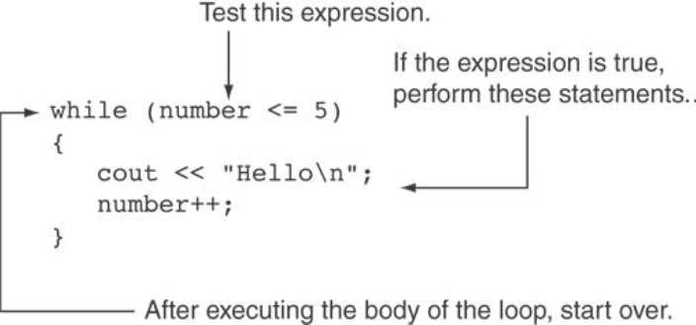
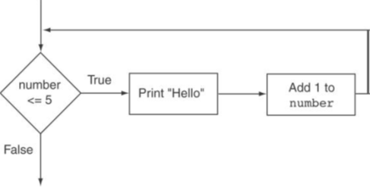
Understanding while

Slide 6
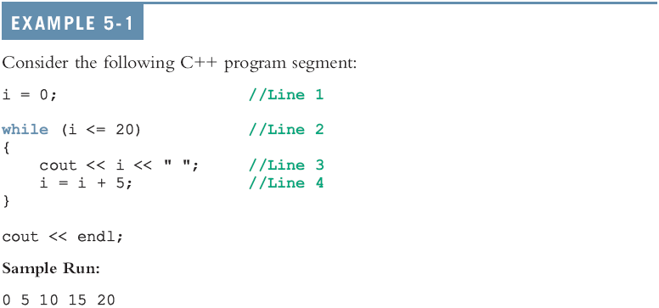
while Looping (Repetition) Structure (cont'd.)
Initialize before using
Loop Control Variable
Omit this
25 is not printed Why?

Slide 7
Examples
i = 0;
while (i <= 20)
{
cout << i << " " ;
i = i + 5 ;
}
cout << endl ;
Here is the output
0 5 10 15 20
i = 0;
while (i <= 20);
{
i = i + 5 ;
cout << i << " " ;
}
cout << endl ;
//What will be the output
5 10 15 20 25

Slide 8
Designing while Loops

Slide 9
Types of while loops
Counter-controlled while loop
Sentinel-controlled while loop
Flag-Controlled while loop

Slide 10
Counter-Controlled while Loops
If you know exactly how many pieces of data need to be read,
while loop becomes a counter-controlled loop with loop control variable (LCV)
counter = 0 ; //initialize the loop control variable
while (counter < N) //test the loop control variable
{
.
.
.
counter++ ; //update the loop variable
.
.
.
}

Slide 11
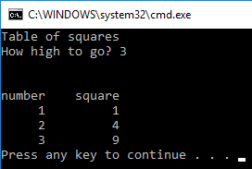
User Controls the Loop Example
int num, limit;
cout << "Table of squares\n";
cout << "How high to go? ";
cin >> limit;
cout << "\n\nnumber" << setw(10) << "square" << endl;
num = 1;
while (num <= limit)
{
cout << setw(6) << num << setw(10)
<< num*num << endl;
num++;
}

Slide 12
Case 2: Sentinel-Controlled while Loops
Sentinel variable is tested in the condition
Loop ends when sentinel is encountered
cin >> variable ; //initialize the loop variable
while(variable != sentinel)//test the loop control variable
{
.
.
.
cin >> variable ; //update the loop control variable
.
.
.
}
Notes:
Reading from a file till eof()
Get input from user until a –ve number is input

Slide 13
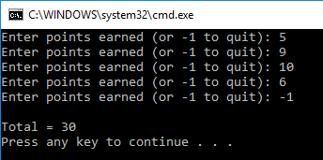
Sentinel Example
int total = 0;
int points;
cout << "Enter points earned (or -1 to quit): ";
cin >> points;
while (points != -1) // -1 is the sentinel
{
total += points;
cout << "Enter points earned (or -1 to quit): ";
cin >> points;
}
cout << "\nTotal = " << total << endl ;

Slide 14
Case 3: Flag-Controlled while Loops
A flag-controlled while loop uses a bool variable to control the loop
The flag-controlled while loop takes the form:
found = false ; //initialize the loop control variable
while( !found) //test the loop control variable
{
.
.
.
if (expression)
found = true;
.
.
.
}

Slide 15
Example Number guessing game
#include "stdafx.h"
#include "iostream"
#include "cstdlib"
#include "ctime“
using namespace std;
int main() (
int num; //Variable to store the random number
int guess ; //Variable to store the number guessed by the user
bool isGuessed; //Boolean variable to control the loop
srand(time(0)); //Sets the random number's seed to current time
num = rand()%100; //Generates a random number between 0-99
isGuessed = false; //Initializes flag to false
while(!isGuessed) {
cout << "Enter an integer in the range 0-99 : " ;
cin >> guess ;
cout << endl;
if(guess == num){
cout <<"You entered the correct number" << endl;
isGuessed = true;
}
else if(guess < num){
cout << "Your guess is lower than the number\nGuess again!" <<endl ;
}
else {
cout << "Your guess is higher than the number\nGuess again!" <<endl ;
}
}
return 0;
}

Slide 16
More on Expressions in while Statements
The expression in a while statement can be complex
For example:
while ((noOfGuesses < 5) && (!isGuessed))
{
…
}

Slide 17
Example
Get the first two Fibonacci numbers.
Get the desired Fibonacci number. That is, get the position, n, of the Fibonacci number in the sequence.
Calculate the next Fibonacci number by adding the previous two elements of the Fibonacci sequence.
Repeat Step 3 until the nth Fibonacci number is found.
Output the n^{th} Fibonacci number.

Slide 18
#include <iostream>
using namespace std;
int main()
{
//Declare variables
int previous1, previous2, current;
int counter, nthFibonacci;
cout << "Enter the first two Fibonacci "
<< "numbers: ";
cin >> previous1 >> previous2;
cout << endl;
cout << "The first two Fibonacci "
<< "numbers are "
<< previous1 << " and "
<< previous2 << endl;
cout << "Enter the position of the “
<< "desired Fibonacci number: ";
cin >> nthFibonacci;
cout << endl;
if (nthFibonacci == 1)
current = previous1;
else if (nthFibonacci == 2)
current = previous2;
else
{
counter = 3;
while (counter <= nthFibonacci)
{
current = previous2 + previous1;
previous1 = previous2;
previous2 = current;
counter++;
}//end while
}//end else
cout << "The Fibonacci number at "
<< "position " << nthFibonacci
<< " is " << current << endl;
return 0;
} //end main

Slide 19
Fibonacci Number Sample Runs
Sample Run 1:
Enter the first two Fibonacci numbers: 12 16
The first two Fibonacci numbers are 12 and 16
Enter the position of the desired Fibonacci number: 10
The Fibonacci number at position 10 is 796
Sample Run 2:
Enter the first two Fibonacci numbers: 1 1
The first two Fibonacci numbers are 1 and 1
Enter the position of the desired Fibonacci number: 15
The Fibonacci number at position 15 is 610

Slide 20
for Looping (Repetition) Structure
The general form of the for statement is:
The initial statement, loop condition, and update statement are called for loop control statements
initial statement usually initializes a variable (called the for loop control, or for indexed variable)
In C++, for is a reserved word

Slide 21
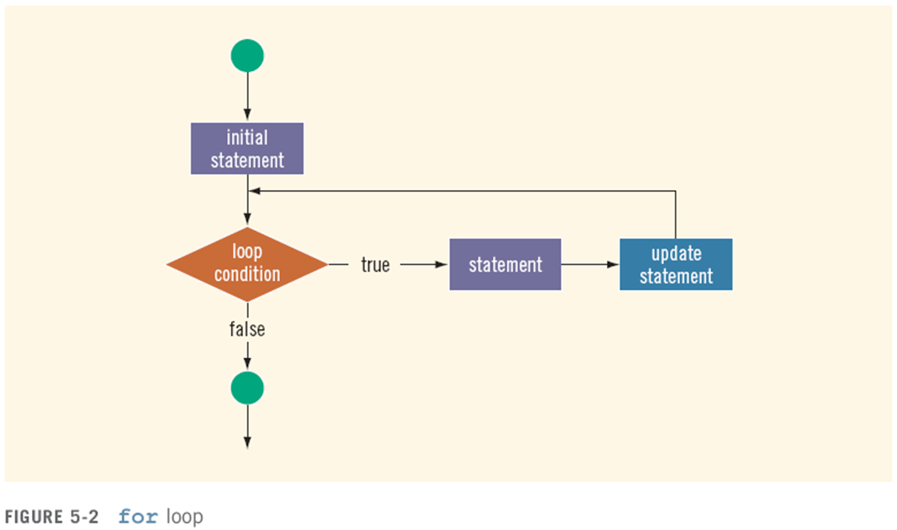
for Looping (Repetition) Structure (cont'd.)

Slide 22
for Loop Example
int sum = 0, num;
for (num = 1; num <= 10; num++)
sum += num;
cout << "Sum of numbers 1 – 10 is "
<< sum << endl;

Slide 23
More for Loop
The following for loop output Hello! And a star (on separate lines) five times
for (i = 1; i <= 5; i++)
{
cout << "Hello!" << endl;
cout << "*" << endl;
}
Consider the following for loop
for (i = 1; i <= 5; i++)
cout << "Hello!" << endl;
cout << "*" << endl;
This loop outputs Hello! Five times and the star only once. Note that the for loop controls only the first output statement because the two output statements are not made into a compound statement. Therefore, the first output statement executes five times because the for loop body executes five times. After the for loop executes, the second output statement executes only once. The indentation, which is ignored by the compiler, is nevertheless misleading.

Slide 24
More for Loop
The following for loop executes five empty statements:
for (i = 0; i < 5; i++); //Line1
cout << "*" << endl; //Line2
The semicolon at the end of the for statement (before the output statement, Line) terminates the for loop. The action of this for loop empty, that is, null

Slide 25
for Loop Notes
If test is false the first time it is evaluated, the body of the loop will not be executed
The update expression can increment or decrement by any amount
Variables used in the initialization section should not be modified in the body of the loop

Slide 26
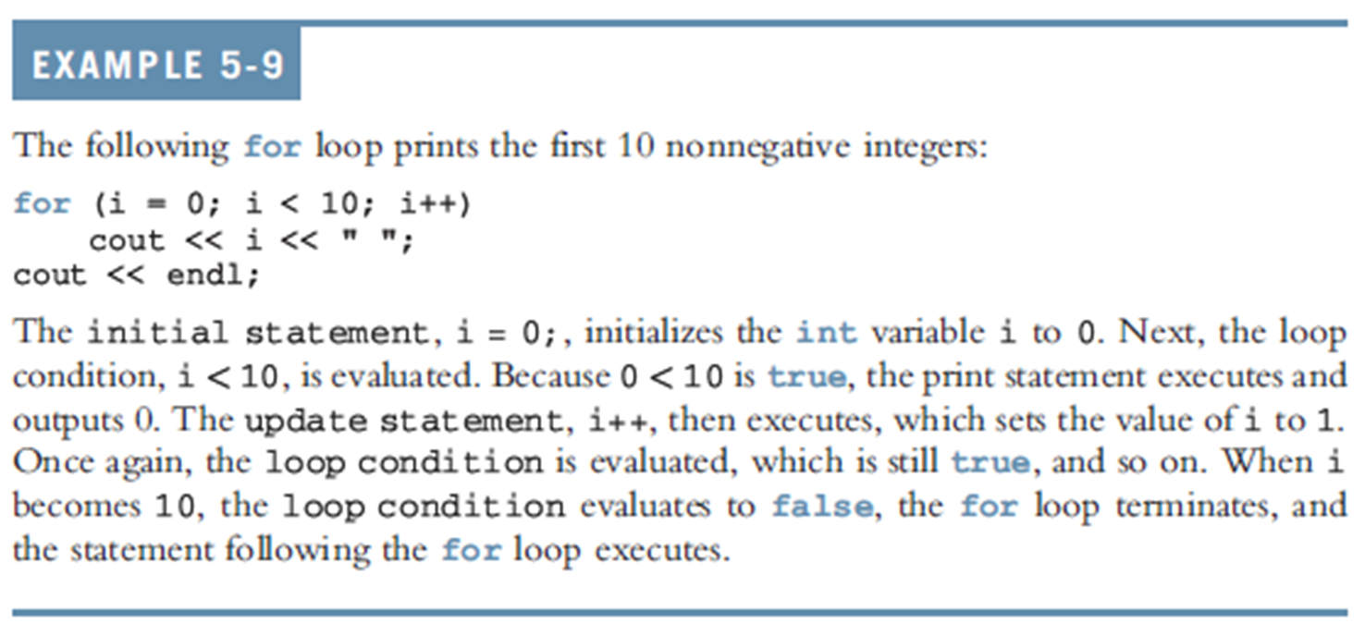
for Looping (Repetition) Structure (cont'd.)

Slide 27
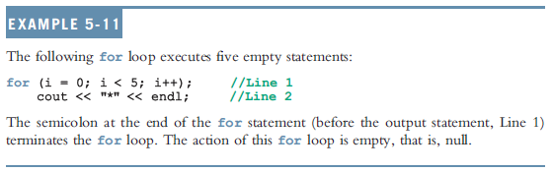
for Looping (Repetition) Structure (cont'd.)
C++ allows you to use fractional values for loop control variables of the double type
Results may differ
The following is a semantic error:
The following is a legal for loop:
for(;;)
cout << "Hello " << endl;

Slide 28
More for Loop
1. Consider the following for loop
for(int i = 10 ; i <= 9 ; i++)
cout << i << " " ;
cout << endl;
In this for loop initial statement sets i to 10. Because initially the loop condition (i <= 9) is false. Nothing happens.
2. Consider the following for loop
for(int i = 9 ; i >= 10 ; i--)
cout << i << " " ;
cout << endl;
In this for loop initial statement sets i to 10. Because initially the loop condition (i >= 10) is false. Nothing happens.
3. Consider the following for loop
for(int i = 10 ; i <= 10 ; i++) //Line 1
cout << i << " " ; //Line 2
cout << endl; //Line 3
In this for loop initial statement sets i to 10. Because initially the loop condition (i <= 10) is true, so the output statement in Line 2 executes, which outputs 10

Slide 29
4. Consider the following for loop
int i;
for(i = 1 ; i <= 10 ; i++); //Line 1
cout << i << " " ; //Line 2
cout << endl; //Line 3
This for loop has no effect on the output statement in line 2. The semicolon at the end of the for loop ends the for loop; the action of the for loop is thus empty. The output statement is all by itself and hence runs only once.
5. Consider the following for loop
for(int i = 1 ; ; i++)
cout << i << " " ;
cout << endl;
In this for loop because the loop condition is omitted from the for statement, the loop statement is always true. This is an infinite loop.

Slide 30
for Loop Modifications
Can define variables in initialization code
Their scope is the for loop
Initialization code, test, or update code can contain more than one statement
Separate statements with commas
Example:
for (int sum = 0, num = 1; num <= 10; num++)
sum += num;

Slide 31
More for Loop Modifications (These are NOT Recommended)
Can omit initialization if already done
int sum = 0, num = 1;
for (; num <= 10; num++)
sum += num;
Can omit update if done in loop
for (sum = 0, num = 1; num <= 10;)
sum += num++;
Can omit test – may cause an infinite loop
for (sum = 0, num = 1;; num++)
sum += num;

Slide 32
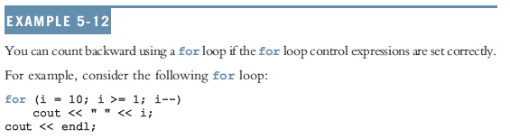
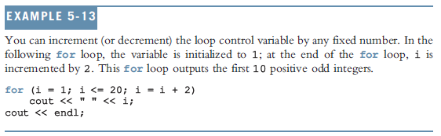
for Looping (Repetition) Structure (cont'd.)

Slide 33
Example
Revise the Fibonacci numbers using for loop.

Slide 34
Example
for (int previous1 = 1, previous2 = 1, counter = 3, current ; counter <= nthFibonacci ; counter++)
{
current = previous2 + previous1;
previous1 = previous2;
previous2 = current;
}//end for

Slide 35
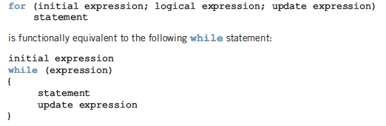
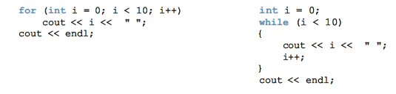
for Vs while

Slide 36
Questions

